Slide 1

Check-in

Slide 2




Information Systems, Dashboards, & Data Analytics

Slide 3
Recap
Other exploratory research methods
Data mining
Case Analyses
Ethnography
Projective Methods
Types of research design
Exploratory
Descriptive
Causal: Conditions for Causality

Slide 4
iClicker Question
Why do we use projective methods?
To project future sales
To probe into hard questions (e.g., STD or racism studies)
Both A and B

Slide 5
iClicker Question
How many conditions are there to establish causality?
2
3
4
Notes:
So what are they? Can anyone restate it?
Again, we want to say that if there is one thing you can get away from this class is correlation does mean causation and when it does.

Slide 6
iClicker Question
Which setting is more appropriate to establish internal validity?
Lab Experiment
Field Study

Slide 7
iClicker Question
A
B
Which variable is the independent variable in the diagram?
Hint: you have control over A, but not B.
A
B

Slide 8
iClicker Question
Do you agree with the following statement:
External validity is how well the outcome of a study can be expected to apply to other settings
Yes
No

Slide 9
Learning Objectives
Define the difference between secondary data and primary data
Secondary data are statistics not gathered for the immediate study, but for other purpose.
Primary data are originated by the researchers for the purpose of the investigation at hand.
List the advantages and disadvantages of working with secondary data
Define what is meant by a marketing information system (MIS) and decision support system (DSS)
Identify the components of a decision support system
Discuss knowledge management.

Slide 10
Marketing Research Process
Once the problem has been defined, the next step is to determine if the information needed to solve the problem already exists

Slide 11
The Marketing Research Process
Notes:
Just to remind you in chapter 2, we saw this diagram already. We have 4 phases:
Problem definition
Data collection
Data analysis
Information reporting
We have gone over exploratory research, and defined information need
Now we need to think how we would obtain these data

Slide 12

Primary Data
Information collected specifically for the investigation at hand

Slide 13
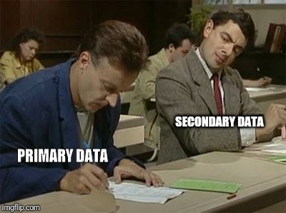
Secondary Data
Data that have already been collected, often for some other purposes or by some other organization

Slide 14
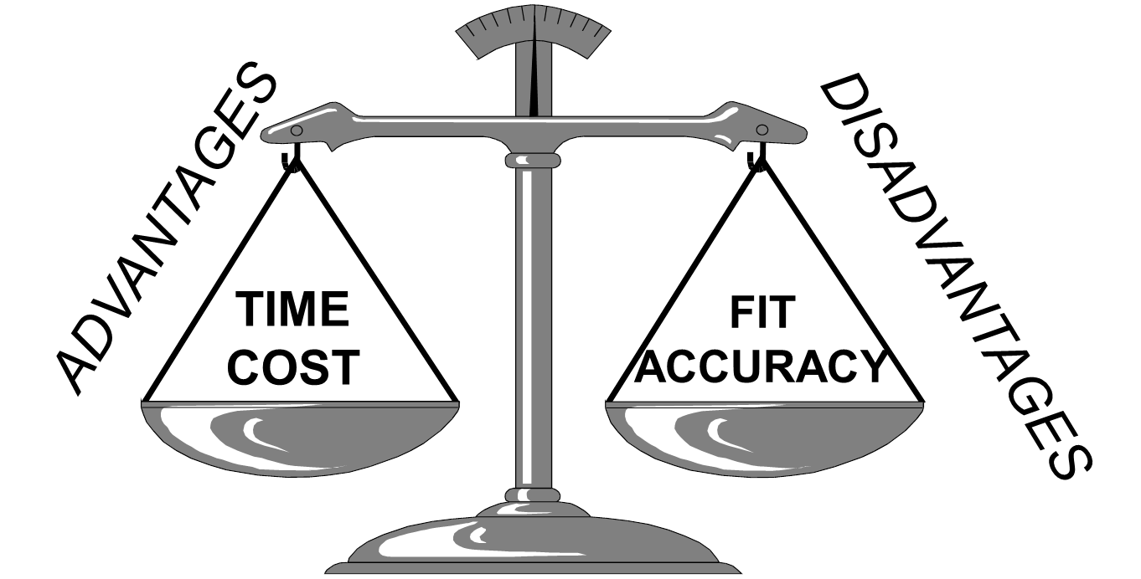
The Balancing Act with Secondary Data
Notes:
Inexpensive data can be secured quickly, but unknown accuracy or ill-fitting for the problem
Expensive data can fit better with our problems, and have better accuracy
You can also think of expensive in the sense that it takes you a lot of time to collect if you were to collect primary data
But how can you assess the accuracy of your dataset

Slide 15
Assessing the Accuracy of Secondary Data
Primacy of Source
Primary Source: the originating source of secondary data
Secondary Source: a source of secondary data that did not originate the data but rather secured them from another source.
Sponsor of the Research
Advocacy Research: research conducted to support a position rather than to find the truth about an issue
Evidence of Quality
Look for evidence that the researchers did a competent job. This usually means that they will have provided enough details about how the research was conducted. If they didn’t … be careful
Notes:
There are multiple ways to assess the accuracy of secondary Data
First we have to assess the source of data,
In secondary source, we have to assess the originating source of secondary data,
And if your secondary data seller is an aggregator, you have to assess how they secure those dataset.
Secondly,
You have to assess who sponsor the research. Why do you think we have to assess this aspect? And can you give me an example of why?
Example: Coca cola sponsors diabetes research, or tobacco companies sponsor lung cancer research
Lastly, the evidence of quality
We can see if the researchers did a competent job …

Slide 16
Traditional Types of Internal Secondary Data
Transaction Data
For example, B2B sales invoices, retail receipts, online transactions, shopping card data
Customer Communications
For example, inquiries, complaints via telephone, online, mail, in-person.
Marketing Research Tracking Studies
For example, satisfaction, awareness, image studies
Other Sources
For example, call reports, expense receipts, customer records, financial records, credit memos, warranty cards.
Notes:
These are traditional types of internal secondary data. Say you are from the marketing research department, but you want data on the sales team, the data the sales team give you will be considered internal secondary data.
This slide can be rather boring. But I just want to give you a taste of real-world data

Slide 17
The Evolution & Design of Information Systems
Marketing Information System (MIS)
A set of procedures and methods for the regular, planned collection, analysis, and presentation of information for use in making marketing decisions.
Decision Support System (DSS)
A system that combines data, models for guiding decision, and a user interface that allows users to interact with the system to produce customized info
Customer Relationship Management (CRM)
A system that gathers all relevant information about a company’s customers and makes it available to the employees that interact with the customers.
Notes:
These are types of systems that companies typically use. Please review this slide before taking the quiz because it’s very likely that you will receive a question on it.
I assume that you have already read the definitions of these systems, so I will not repeat it.
I will just give you more insights that the most standardized and used system in every industry is the customer relationship management system.
And if you can use CRM and mentioned it on your resume, it will greatly increase your chance of getting hired.
The other two systems are highly customized to each firm, hence you can’t prepare and you usually have to learn when you are hired. But it’s good to know what the other systems are for.

Slide 18
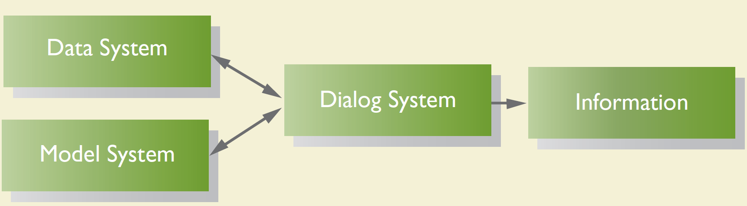
Components of a Decision Support System
Notes:
The part of a decision support system that includes the processes used to capture and the methods used to store data coming from a number of external and internal sources. It is the creation of a database.
The part of a decision support system that includes all the routines that allow the user to manipulate the data so as to conduct the kind of analysis the individual desires. It is the collection of analytical tools to interpret the database.

Slide 19
Limitations of the Systems Approach
Managers won’t always share decision-making processes
Differing data needs across managers
Time costs
Monetary costs
Data availability – analysis is limited to the data that are in the system.
Notes:
So what are the limitations of the systems approach to the decision-making process?
Managers won’t’ always share their decision-making process, which can make it hard to improve it. (they usually don’t because they don’t want to reveal their trade secret)
In a big company, managers can have different needs. For example, sales managers can have different needs from customer service managers.
More it’s costly both in time and monetary sense.

Slide 20
Chapter 6: Decision Support Systems: Working with “Big Data”
Identify the four Vs of “big data”
Contrast structured and unstructured data
Describe the 3 sources of “big data” for marketers
Compare descriptive, predictive, and prescriptive analytical approach
List and discuss the key challenges of “big data” integration
Notes:
These are the learning objectives for chapter 6. But we only skim this chapter since you don’t have to work with big data.
But I think you should still be familiar with this topic

Slide 21
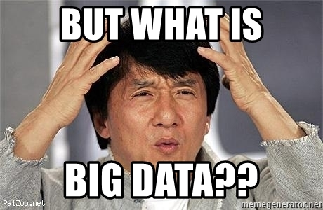
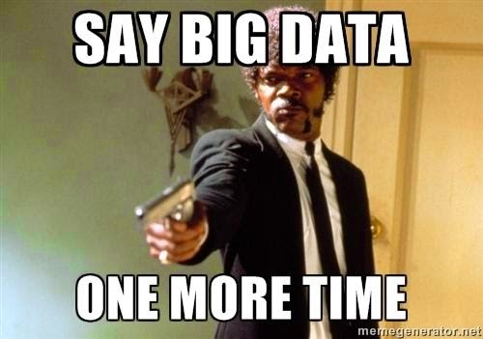
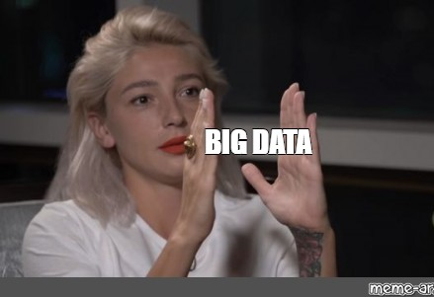
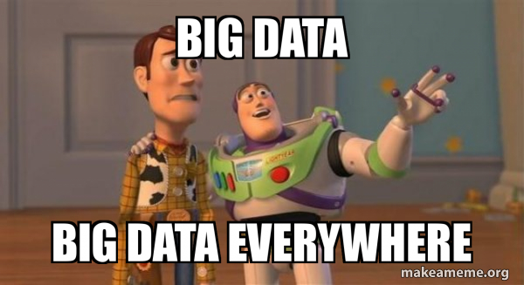
“Big Data” Definition
Big Data is like Teenage sex
Everyone talks about it
Nobody really knows how to do it
Everyone thinks everyone else is doing it
So everyone claims they are doing it
(Dan Ariely)
The process of capturing, merging, and analyzing large and varied data sets for the purpose of understanding current business practices and seeking new opportunities to enhance future performance.
Notes:
So what is big data? Can anyone define it? And why do you think there is such hype regarding big data?
So there is an analogy that is rather famous in the research or statistics or big data world.
Big data is like teenage sex
It quote was by Dan Ariely, a Professor of Psychology and Behavioral Economics
All jokes aside. Big data is the process of …
Basically, big data is the just you analyze datasets using quantitative methods. And statisticians and econometricians have been doing this since forever. I think the hype was because of the unstructured data that are generated from Google, Facebook, or YouTube
Next time, whoever tries to show off by saying these words, you know it’s just data that is big.

Slide 22
The Four V’s of Big Data
Volume: The sheer amount of data being collected in “big data” systems
Velocity: the pace of data flow both into and out of a firm
Variety: The combination of structured and unstructured data collected in “big data” systems.
Veracity: The accuracy and trustworthiness of data collected in “big data” systems.
Value:
Improving customer retention rates
Dealing with Negative WOM
Enhancing Health Care
Creating Personalized Promotions
Notes:
As you read from chapter 6, there are four V’s in big data:
Volume, Velocity, variety, and veracity
People are now proposing a fifth V which is value.
Big data can be used to improve customer retention rates, deal with negative WOM, enhance health care, or create personalized promotions (as you can see on Facebook, or Instagram).
Research Window 6.1: Target, Big Data and You

Slide 23
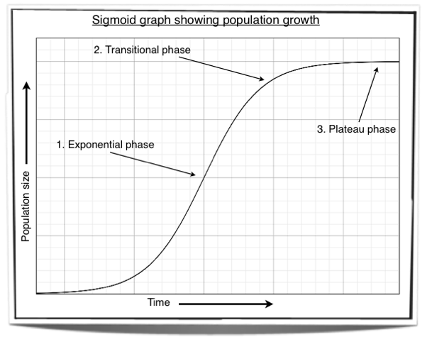
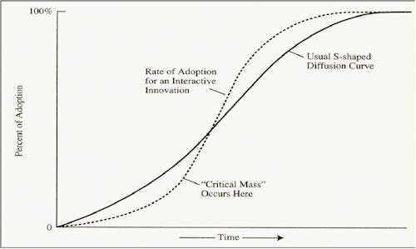
Sigmoid Adoption Curve
Notes:
So I use big data extensively in my research, in which I can give you some first-hand experience.

Slide 24
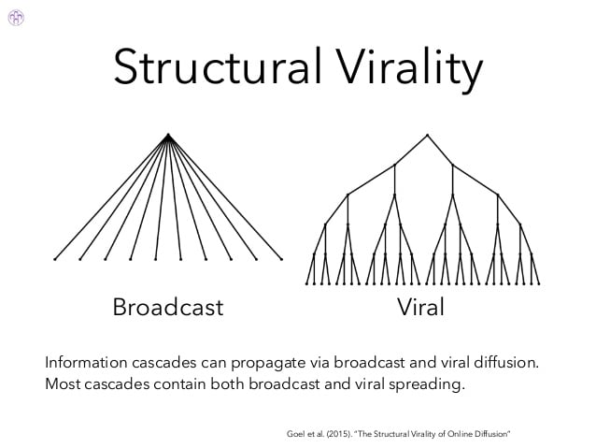
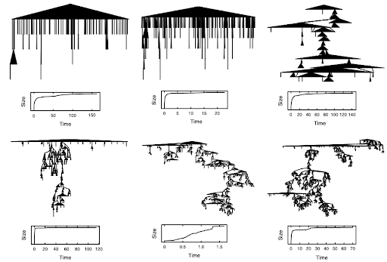
Example of Big Data from structural virality paper Goel et al. (2015)
Notes:
There are only a few cases where you truly need big data
99% of events involve less than two viral adoptions
99% of adoption are less one hop from the seed
Every tweet on Twitter for 12 months (1.4 b obs)
100 RTs, ~ 350 K events
Popularity is driven mostly by the size of the largest broadcast.

Slide 25
Sources of “Big Data”
Structured Data: Data that can be written into rows on a spreadsheet or database based on standard column headings
Ex: transactional data, customer profile information obtained from registration materials or other sources.
Unstructured Data: Data that take the form of social media comments, blog posts, other text-based communication, phots, video, audio, or any other form that is not easily arranged in structured format.
Notes:
I have already mentioned this in the last class when we talked about data mining.
The difference between structure in the sense of dataset, and structure in research design, especially in exploratory research

Slide 26
Key Types of Unstructured Data: Social Data
“Voice of the Customer” Data: unstructured posts on social media networks such as Facebook, Twitter, Google+, YouTube, Instagram, LinkedIn, Tumblr, Pinterest, etc.
Social Network Analysis: a popular tool for studying the social connections between people
Smartphone and Tablet Data: data from texting, in-store shopping
Location-based Services: geo-targeted text messages, mapping services, locating-sharing, location data from call records.
Notes:
These are key types of unstructured data, which are usually social data
Social data can be voice of the customer:
Which then can be used to do social network analysis. It is a popular tool …
Then, we have smartphone data, which consist of data form texting, and in-store shopping or location-based services.
Today, I will use the 5-min snippet to demonstrate SNA

Slide 27

Key Types of Unstructured Data: Omni-channel Transactional Data
Data that are connected to particular purchaser across multiple purchasing channels. Data across different platforms in potentially different formats are collected and tied together.
Notes:
Another type of unstructured data is omni-channel transactional data
The definition of this type of data is data that are connected to a particular purchaser across multiple purchasing channels.
Data across different platforms in potentially different formats are collected and tied together.
Has anyone here have a feeling that all your devices are connected/talk to one another?
And maybe Facebook knows that you are interested in buying a pair of pants when you just talk to your mom about it?
Companies leverage this type of data to get you to buy stuff. Even though it’s hard to connect data across channels, but once you can do it, it’s very powerful.
As I mentioned in the first few sessions, companies sell your data, this is the type of data that they sell. Instagram, Facebook, Reddit can sell data to Google so they can target their ads even better based on your preference and interests

Slide 28
Types of “Big Data” Analyses
Descriptive Analysis
Designed to enhance understanding of available data to benefit firm performance.
Ex: data mining, data fusion, network analysis, visualization.
Predictive Analysis
Designed to aid both explanatory and forecasting abilities for the betterment of the firm
Ex: regression analysis, time series analysis, simulation
Prescriptive Analysis
Designed to optimize the various course of action available to enhance firm performance
Ex: Optimization tools
Notes:
These are types of big data analyses. It’s similar to our research design
Can someone remind me what the three research designs are?
Exploratory Research
Descriptive Research
Causal Research
We have encountered simulation before, can you state some examples?

Slide 29
Key Challenges of “Big Data” Integration
Access to and retrieval of data (including data integration)
Analytical skills
Firm integration of big data

Slide 30
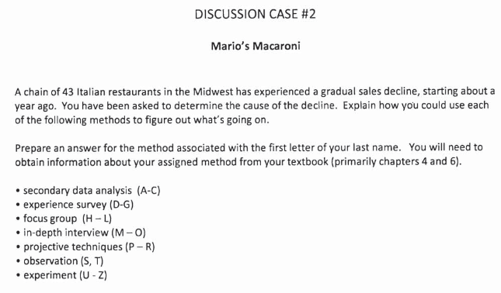
Discussion Case #2
Notes:
(Read the case)
So basically, What could be the potential causes that a restaurant is having a gradual sales decline? Pick a specific method and consider the probable cause
Please state the strengths and weaknesses of your method. Then, you also have to offer details on how you would approach this problem. I will do an example in class.
But you have to do the method associated with the first letter of your last name. Don’t just pick the first one and copy my answer.
What are the strengths of secondary data analysis?
So the strength of secondary data analysis is that you can purchase and do it right away, it can be rather fast. It can give you the result right away.
So what about its weaknesses?
You don’t have control over what type of data you can get
The data can contain a lot of measurement errors (surveyors did not do a good job of obtaining the dataset)
And a way to approach this problem using secondary data analysis is that you can get data from Yelp or Google reviews to see the general market trend to see if it happens to other restaurants or just you.
Then, you can also see that general market trends by analyzing data from the US labor bureau or other governmental agencies that publish market data
I hope this gives some sense to what should be discussed on Canvas.

Slide 31
15-min Group Discussion
PA #3 (Sunday)

Slide 32
Up next
Week 3 Quiz (Sunday)
Assignment #3 (Sunday)
Signup for meeting (Room 449 – Conference room 4th floor)
Please bring a copy or a laptop so we can talk about your assignment

Slide 33
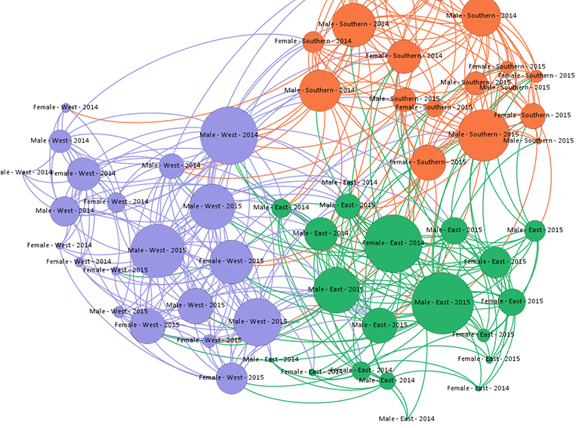
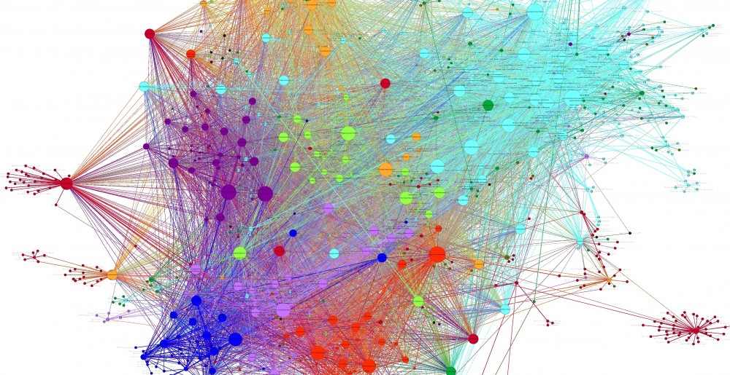
5-min snippet: Social Network Analysis
Notes:
Open Gephi

